Slide 1





i-SCOPE- interoperable Smart City services through an Open Platform for urban Ecosystems Experience of pilots Bruxelles, September 15th, 2015

Slide 2
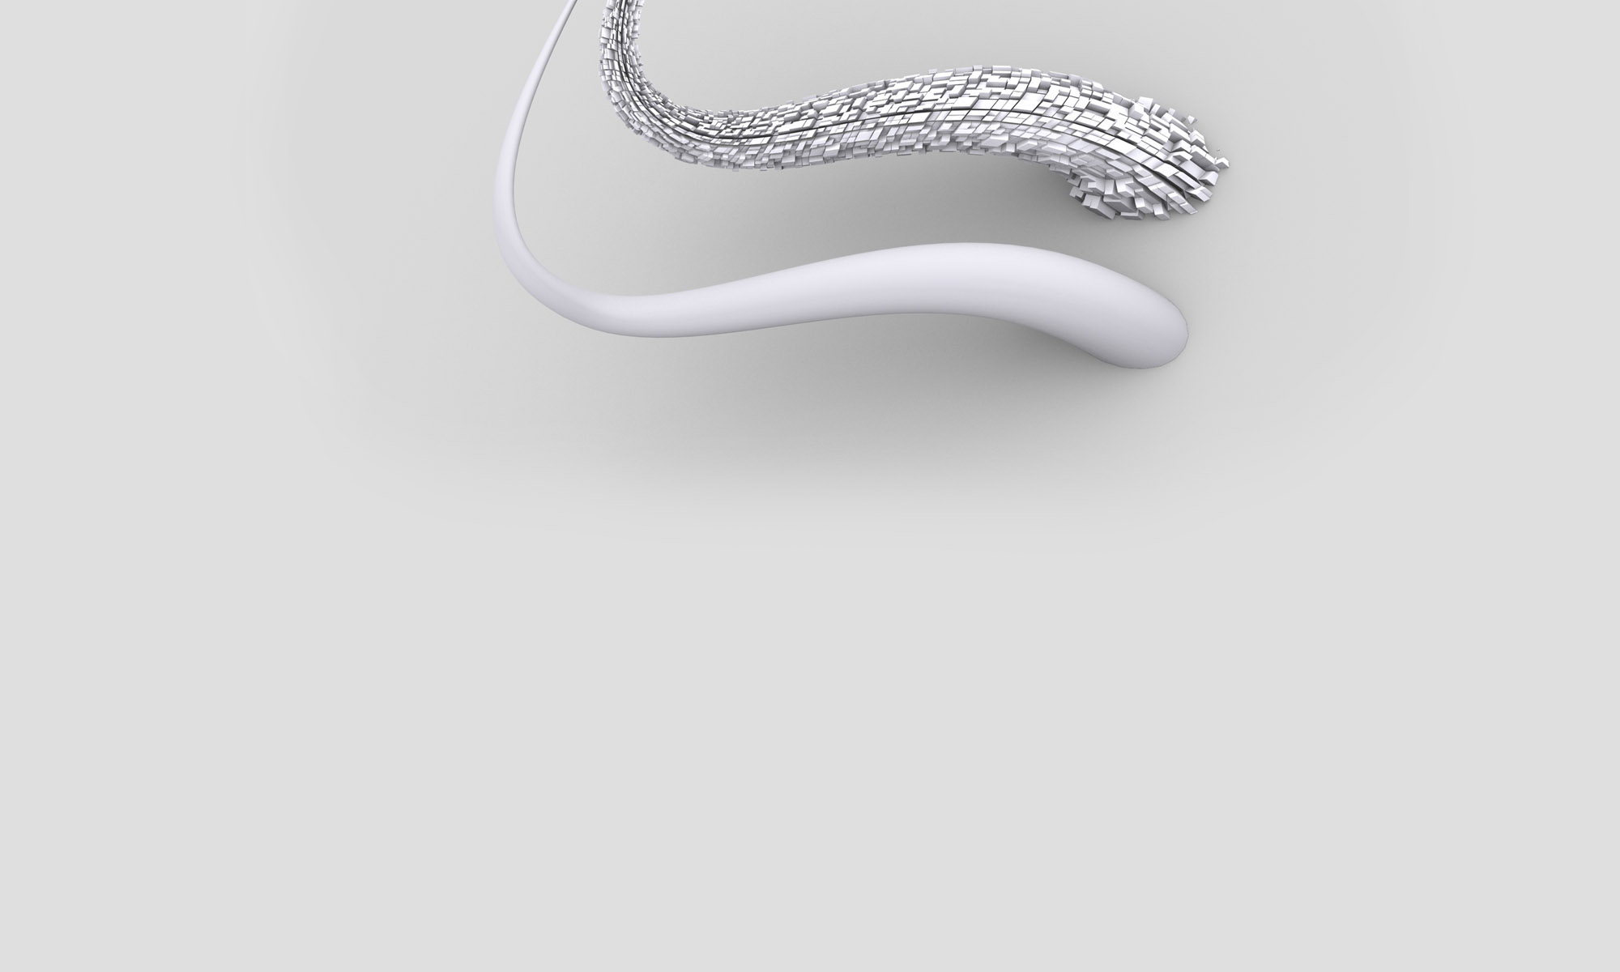

Target groups involved in project (presentation and testing activities)
Representatives of the City Office for Energy, Environment and Sustainable Development
Professionals in installations of renewable energy sources (Members of the Croatian Chamber of Mechanical Engineers, Electrical Engineers and Architects, Croatian Association for Solar Energy)
Educational institutions (“Technical school „Ruđer Bošković”, Faculty of Architecture ; Faculty of Geodesy, Zagreb Technical museum)
Private company- “Končar Inem d.o.o.”

Slide 3

Croatian Chamber of Mechanical Engineers
Members of the Chamber perform, within the professional discipline of mechanical engineering, tasks such as design engineering, auditing, design control and project supervision, and construction project management in the fields of physical planning, building and building products manufacture
Croatian Chamber of Electrical Engineers
The activities of the Association are continuing professional education of members of the chamber and other stakeholders through seminars and traditional Days of Chartered Electrical Engineers, participation in legislation, standardization and other.
Croatian Chamber of Architects
Chamber promotes architecture as an expression of the people and culture of creativity, enhances architectural activity in order to protect the public interest and the interests of third parties.

Slide 4
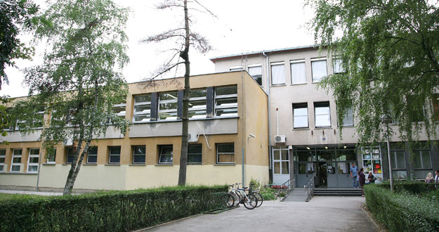
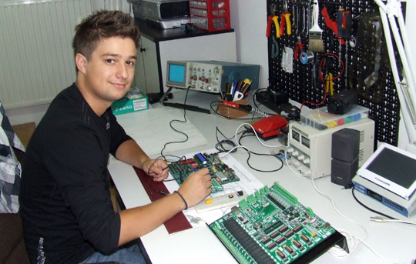
Technical school „Ruđer Bošković”
high school institution with quality teaching staff.
carry out a special education for adults and exam for certification of installers of renewable energy sources (PV)
seminars and courses are designed for all who want to acquire or update knowledge and skills in their professional area important for good performance or because of some personal needs. These programs can be fully adapted to user needs

Slide 5
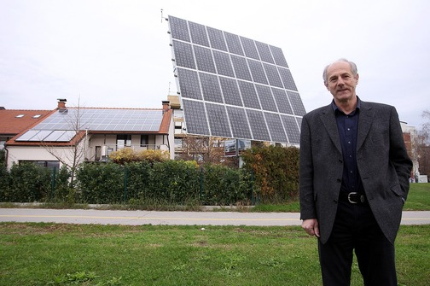
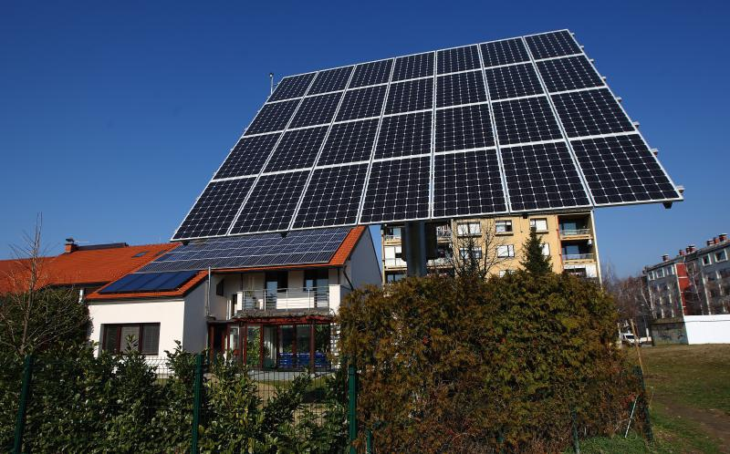
Dr.sc.Ljubomir Majdandžić
President of the Croatian Association for Solar Energy
chief editor of the Solar Technology magazine
creator of the 'Solar Roof-Centar Zagreb‘ project
gives lectures and workshops in the field of renewable energy, energy efficiency, environmental protection, climate change and global warming
owner of the first ‘solar home‘, facility in which it is possible to conduct systematic measurements and obtain savings by using solar energy.

Slide 6
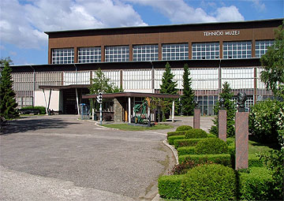
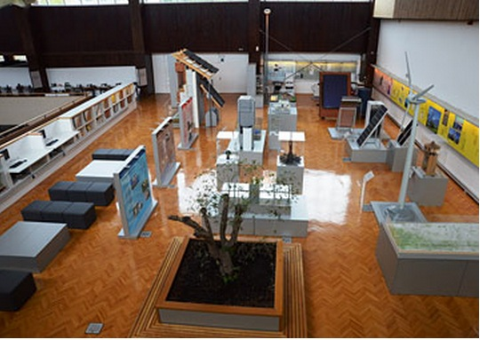
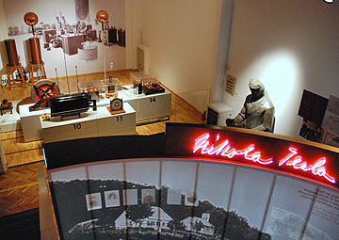
Zagreb Techical museum
the Technical Museum was founded partly with the aim of popularizing science and technology, but a number of years in the Museum were held occasional lectures as part of the Science forums and festivals
special part of the technical museum is place with the theme of Renewable Energy Resources and Energy Efficiency, which is divided into two parts. There is an exhibition part presenting 83 exhibits and separate part with EdukaEnergiana library and space for workshops and presentations. The exhibition part of the department includes nine sections: biomass,biofuels, wind power, solar hot water systems ,solar power, heat pumps connected to the ground, hydro power and energy efficiency in buildings.

Slide 7
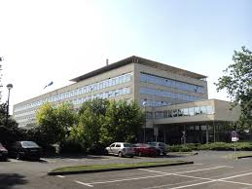
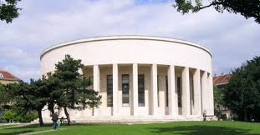
Testing the I-Scope application ( „solar irradiation” scenario )
Meeting with Dr.sc. Ljubomir Majdandžić, President of the Croatian Association for Solar Energy – March, 24th 2015
testing and validation of calculated data on the example of the Main building of City Administration with installed PV power plant of 28,8kW (based on comparing the data between actual production and I-Scope calculation)
testing was carried out on the example of the Meštrović Pavilion and the City Administrative building

Slide 8
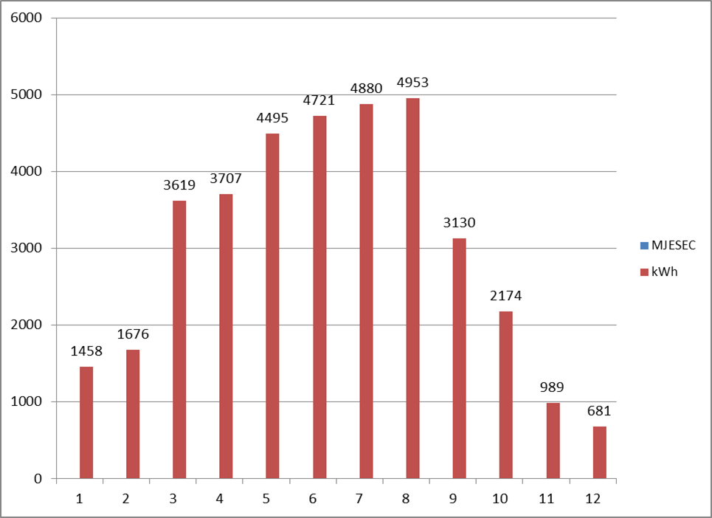
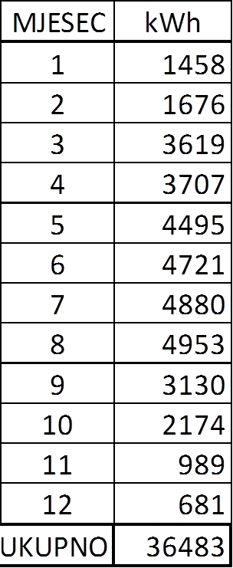
Testing I-Scope application ( „solar irradiation” scenario )
the data of actual produced electricity on installed PV power plant (28,8kW) of the Main building of City Administration

Slide 9
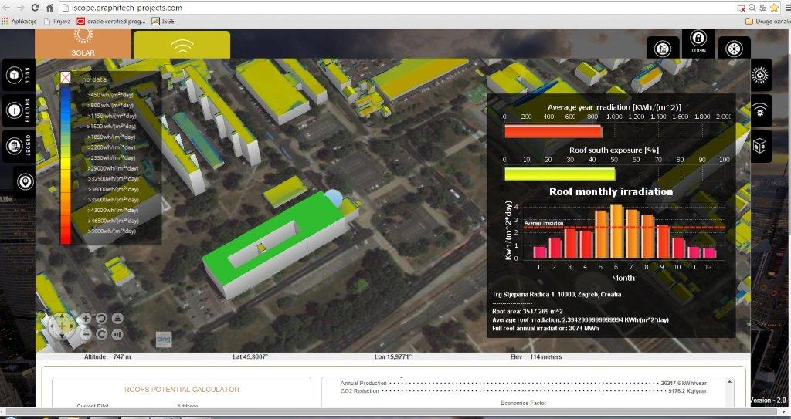
Testing the I-Scope application ( „solar irradiation” scenario )

Slide 10
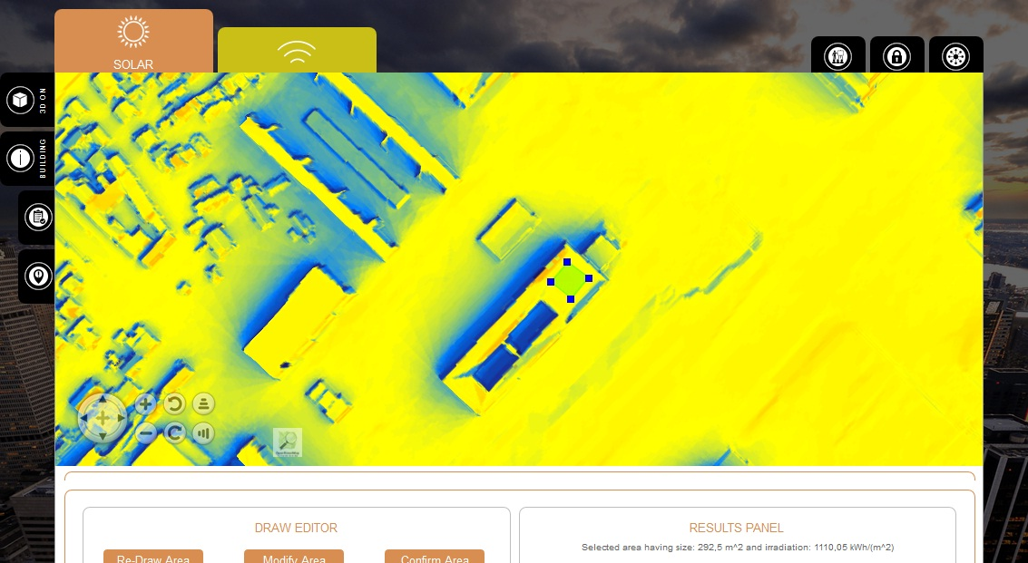
Testing the I-Scope application ( „solar irradiation” scenario )

Slide 11
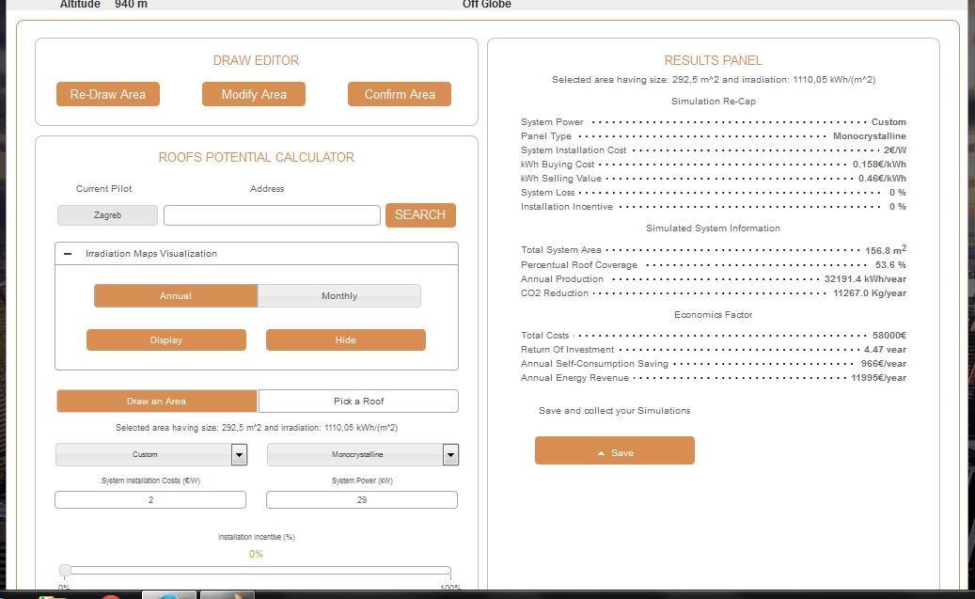
Testing of the I-Scope application ( „solar irradiation” scenario )
data obtained by the application relating to total annual energy production are slightly different from actual production data (lower than achieved in actual production)
Reason-higher production achieved by setting up the PV panel at the optimum angle

Slide 12
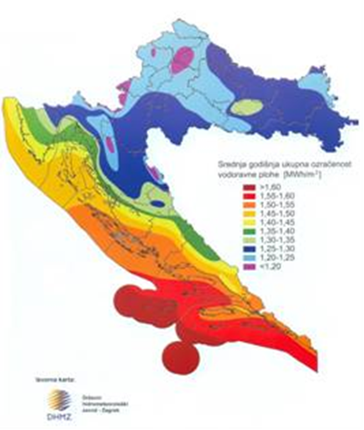
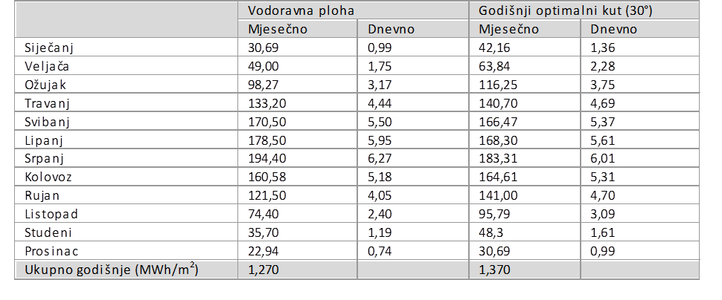
Testing the I-Scope application ( „solar irradiation” scenario )
The values of average insolation in Croatia obtained by Croatian Meteorological and Hidrological Service

Slide 13
Testing the I-Scope application ( „solar irradiation” scenario )
good remarks:
application opens relatively quickly
easy to use ( quick search and calculation)
good 3D visualization
adequate amount of information and calculated data
calculation of return of investments
detailed and useful instructions for users
insight into other cities that are partners in the project

Slide 14
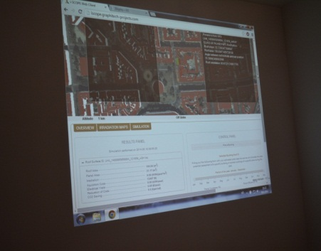
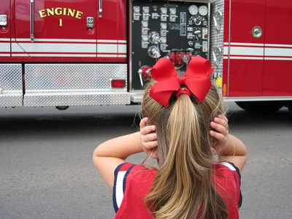
Testing the I-Scope application ( „noise” scenario )
Meeting with Mrs.Vesna Poslončec-Petrić, Professor of Geodesy – January, 15th 2015
we established cooperation with the Faculty of Geodesy and presented the objectives of the I-Scope project, its main goals and scenarios and purpose of the IT application for solar irradiation calculation and noise recording
it was shown great interest and students were willing to help us in further testing and dissemination of the application by making noise maps within pilot area

Slide 15
Testing the I-Scope application ( „noise” scenario )
students of Geodesy students were given the task to test the I-Scope application (noise scenario ) using their mobile phones
measurements are collected in the afternoon and uploaded to Google Earth for visual display

Slide 16
Testing the I-Scope application ( „noise” scenario )
noise measured by the application was ranging from 30 to 110 dB ( the strength of the noise that causes hearing damage rangs from 80 to 90 dB )
total of measurements is 18,782 measurements
minimum noise level recorded by the students was less than 30dB
maximum noise level recorded by the students was 108 dB

Slide 17
Testing the I-Scope application („noise” scenario )
good remarks:
application opens quickly
easy to use
good 3D visualization
detailed instructions for users
useful information for users
insight into other cities that are partners in the project

Slide 18
Testing of the beta version of the I-Scope application („noise” scenario )
good remarks:
allows citizens to measure the noise exposure in their daily environment
everyone can participate in the creation of collective noise mapping by sharing its geo-referenced measurements by Noise Tube application
performed measurements can be complemented with labels such as information about the source of noise (traffic, airplane, people)

Slide 19
User’s experience and satisfaction
people unwilling to fill in the online questionnaire because they can just skip it
too long to load system
users are not able to zoom the map
missing calculation for solar collector for hot water
it should be included the whole city, not only the pilot area

Slide 20
Project endorsed by City of Zagreb
In accordance with the Action Plan for Sustainable Energy , City of Zagreb has been implementing a project of renewable energy to produce hot water as well as electricity generating facilities owned by the City
the last several years, the City of Zagreb has opened a tender for the subsidized costs of purchasing and installing renewable energy systems for legal entities and individuals
the I-Scope application is an adequate tool for solar irradiation calculation and direct economic benefits. It can stimulate the development of solar energy usage and improve the quality of life.

Slide 21
Project endorsed by City of Zagreb
the City of Zagreb has made its strategic noise map, which includes the strategic map of road traffic noise, strategic of the railway traffic and strategic map of industrial facilities.
based on results of the strategic noise map it will be prepared an action plan for noise protection from individual noise sources.
by the I-Scope application citizens can easily get information about the surrounding noise just by simple recording of the noise in their everyday environment

Slide 22
Involving citizens and more experts
Zagreb Energy Week (11th – 16th May 2015) – great event and opportunity to present the I-Scope project and invite more experts and as many citizens to take a look at the I-Scope website and to inform about the project and to run its IT application.
on May 12th, 2015 the I-Scope project was presented to representatives of the Croatian Chamber of Mechanical Engineers, Electrical Engineering and Architecture
on the last day, May 16th there was an exhibition on the Main Square "Josip Jelačić" where citizens could get some information about the project , take some flyers and get informed about it

Slide 23
Suggestions
enable calculation for solar collector for hot water
expand the pilot area on the whole city
inform users of application about the possibility of higher energy production in dependence on installed angle of PV panels
speed up and make easy first opening of application as much as possible
for the city administration users enable the report of total amount of solar potential city roofs

Slide 24
Damir Loncaric City of Zagreb City Office for Energy, Environment and Sustainable Development E-mail: damir.loncaric@zagreb.hr

